Slide 1
F# in the Open Source World
Don Syme, Keith Battocchi
@dsyme, @kbattocchi
F# Community Contributors

Slide 2
Nb. This talk has some slides provided by others, as noted

Slide 3
Agenda
A tour through our broadening horizons
Some thoughts on Ecosystems, Exosystems and Type Providers

Slide 4
Overview
F# is changing…
…in subtle but important ways
F# runs on many platforms
“F# is for Windows”

Slide 5
Overview
F# is changing…
…in subtle but important ways
“F# has many contributors”
“Microsoft
makes F#”

Slide 6
Overview
F# is changing…
…in subtle but important ways
“F# is
one language with many tools”
“F# is part of
Visual Studio”

Slide 7
Overview
F# is changing…
…in subtle but important ways
Many perspectives
http://fsharp.org
One perspective
(Microsoft’s)
http://msdn.microsoft.com

Slide 8

Old think…

Slide 9
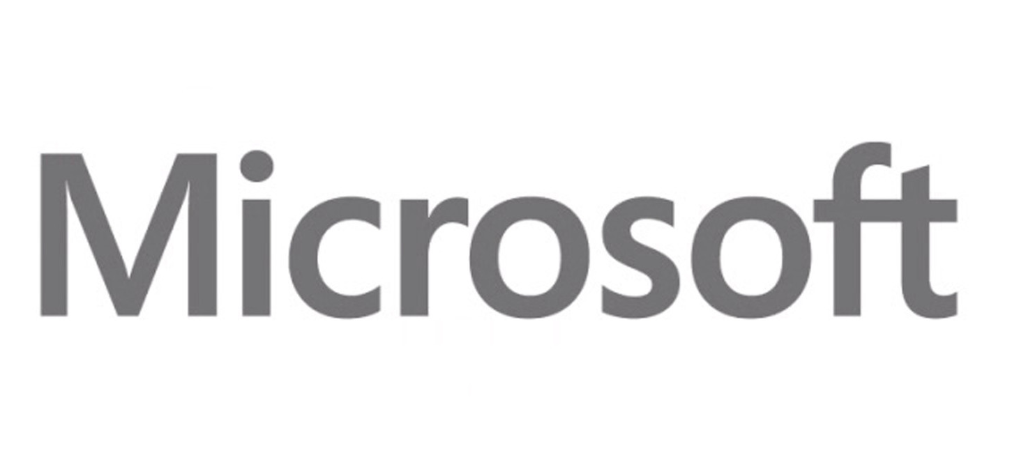


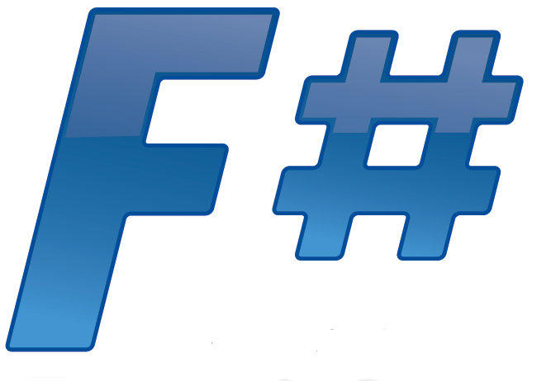



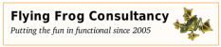

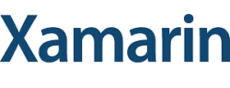



New think…
Visual Studio, .
.NET, SDKs, Tools
…
Visual F# Tools
F# Language
F# Open Source
Group
tryfsharp.org
F# Software
Foundation
F# Community
Groups
fpish.net
tryfs.org
fssnip.net
tryfs.org
fsharpforfunandprofit.com
Xamarin Studio

Slide 10
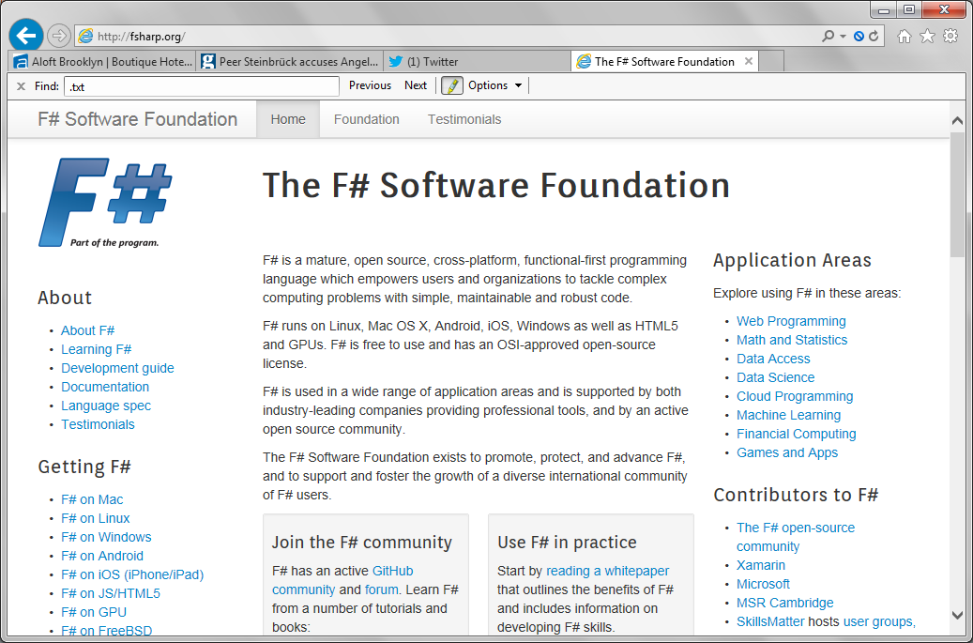
http://fsharp.org
Working Groups:

Slide 11
Why do Microsoft contribute to F#?

Slide 12
functional-first = simple code to solve complex problems = improved time-to-market for code-heavy programming

Slide 13
But let’s look more broadly…

Slide 14
Tour: Core Components

Slide 15
F# Compiler “Open Edition” http://github.com/fsharp/fsharp
F# 3.0
Compiler drops from Microsoft
Community are ok with this
Mac, Linux, Windows, Browsers, Android, iOS
Compiler, Library, Build, F# Interactive, API
Apache 2.0 license
Maintained by fsharp.org
fsharp.github.com/fsharp

Slide 16
Tour: Libraries and Packages

Slide 17
nuget.org

Slide 18
16,000 unique packages 98,000,000 package downloads Windows, Mac, Linux .NET-oriented, many x-platform and open source Nearly all can be used with F# Contribute your own

Slide 19
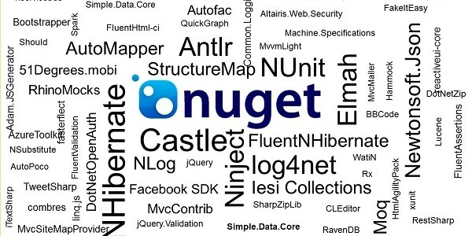
www.nuget.org

Slide 20
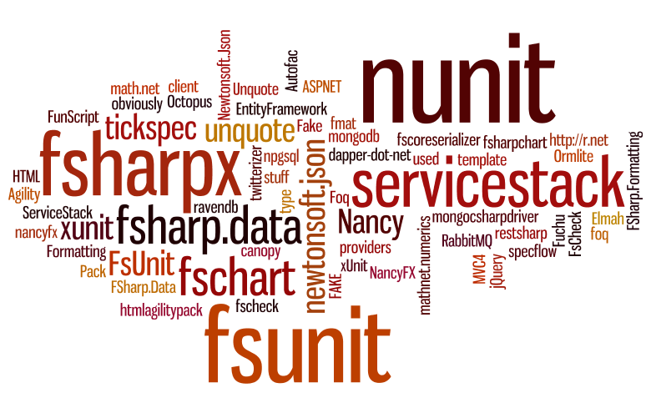

Slide 21
FSharp.Data FSharp.Charting FSharpx ExtLib

Slide 22
Latest news: Data Frames for F# BlueMountain Capital, contributing to F# open source work

Slide 23
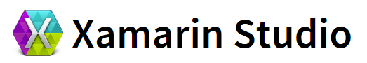


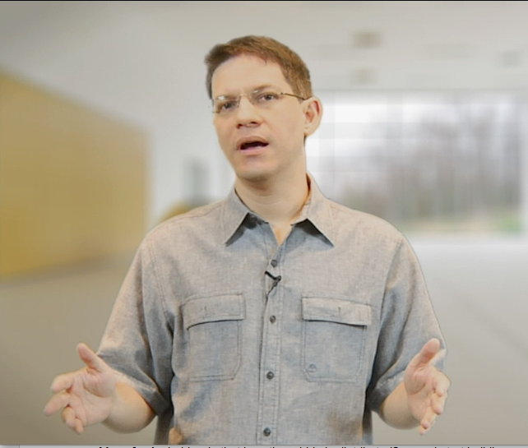




Tour: IDEs

Slide 24
F# in Emacs https://github.com/fsharp/fsharpbinding/

Slide 25
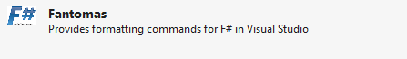
Fantomas https://github.com/dungpa/fantomas/ Ctrl-K Ctrl-F Code Formatting for F#

Slide 26
FSharpBinding F# AddIn for MonoDevelop and Xamarin Studio https://github.com/fsharp/fsharpbinding/ Will ship by default in MD 4.0 and XS

Slide 27
New: Tsunami Scripting Tools http://tsunami.io demo videos Can also be embedded in enterprise applications, they can help enable this (contact them)

Slide 28
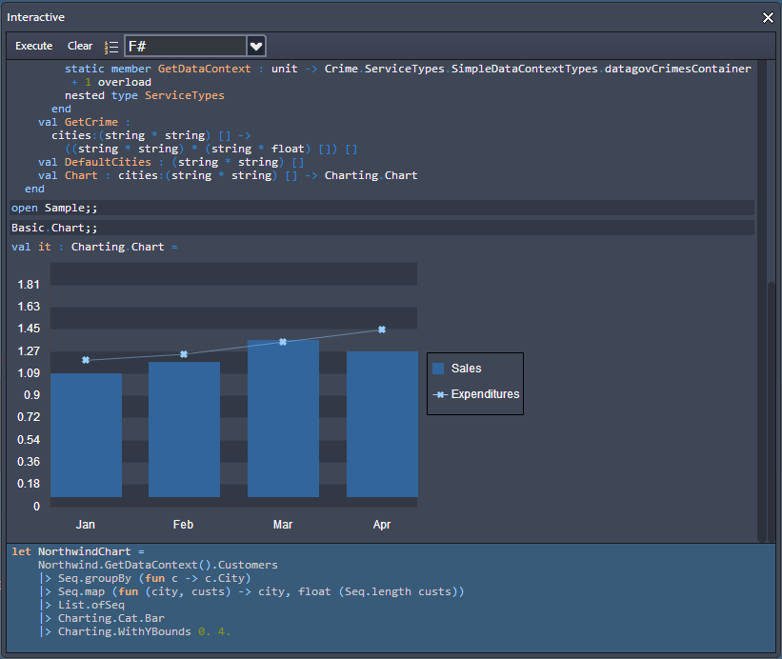
Upcoming:CloudSharper
http://cloudsharper.com
F# Development Environment in the Cloud
Full F# language support
Multi-project solutions
Web and mobile Apps
Syntax highlighting
On the fly type checking
Interactive exploration
Integration with data
Support for type providers

Slide 29
Tour: Web and Service Programming

Slide 30
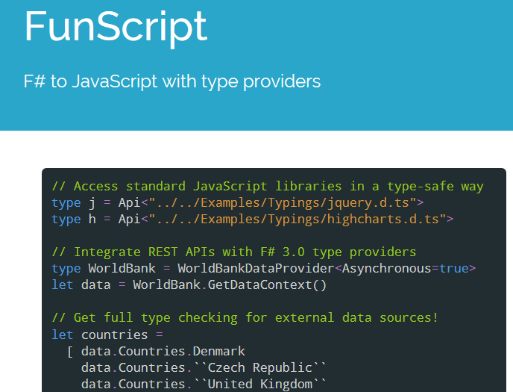
F# to JS via F# quotations
Community made, open-source
Open source license
TypeScript Type Provider for interop

Slide 31
Demo: FunScript

Slide 32
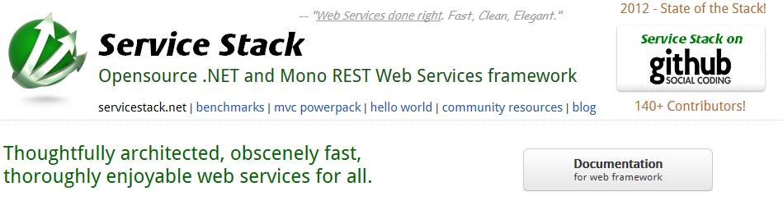
www.servicestack.net

Slide 33
Tour: Cloud Programming

Slide 34
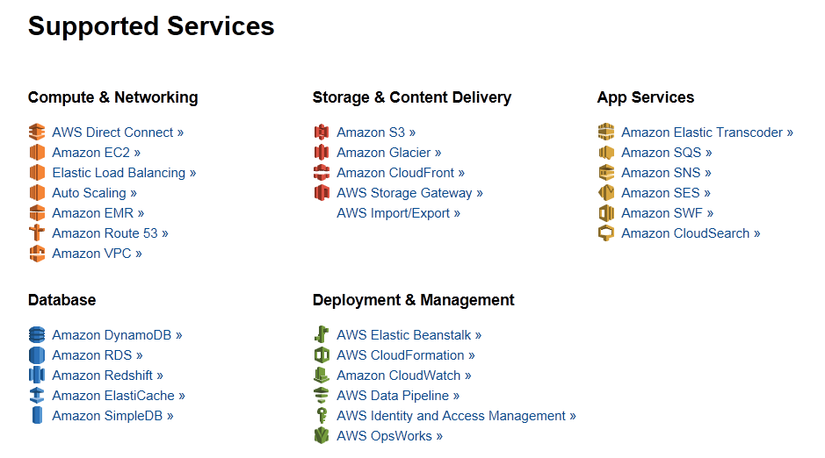
Amazon Web Services .NET SDKs http://aws.amazon.com/tools https://github.com/aws (Apache 2.0)

Slide 35
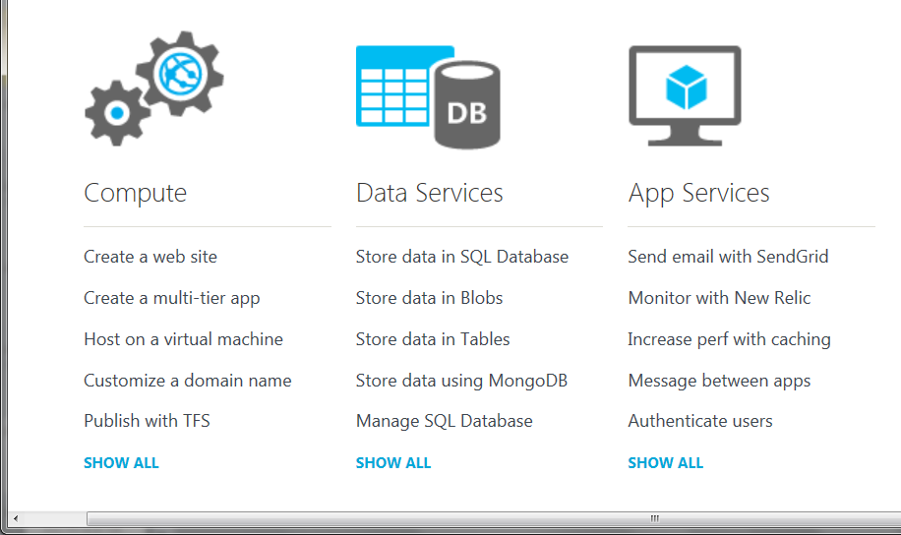
Azure .NET SDKs http://www.windowsazure.com https://github.com/WindowsAzure/ (Apache 2.0)

Slide 36
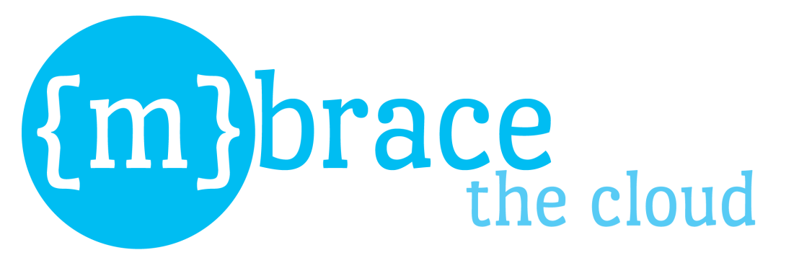


http://m-brace.net
A big data framework for private and public clouds

Slide 37
Tour: Building, Mocking, Testing, …
FAKE, Moq, Foq, Nunit, XUnit, TestSpec, FsUnit, …

Slide 38
Tour: GPGPU Programming
search on nuget for GPU or CUDA!
search on google for “C# GPGPU”

Slide 39
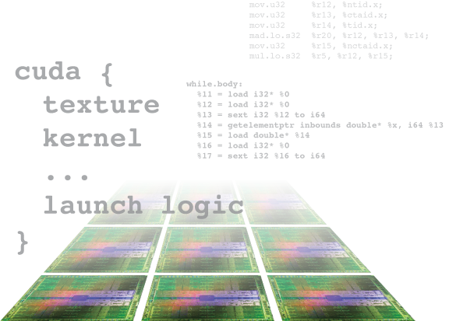
Alea.cuBase
Complete solution to develop CUDA accelerated GPU applications in .NET
Based on LLVM and CUDA 5 technology
Uses F# code quotation
Source code solution
No wrappers, no post build process to transform IL code
Our base technology for GPU projects
Dynamic code
generation
GPU algorithm
scripting
Industry grade
performance
Rapid
development
Solid framework
for reusability
Advanced CUDA programming

Slide 40
Tour: Math and Statistics Packages
See http://fsharp.org/math
Math.NET, ExtremeOptimization, F# for Numerics, FCore, NMath, …

Slide 41
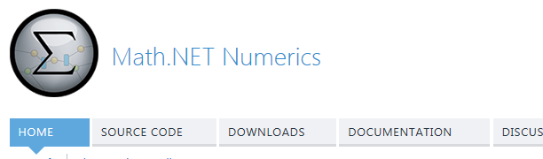
Math.NET Numerics Numerical, Linear Algebra base library Intel MKL support (optional) Classic C#/F# project Some latest news

Slide 42
From Broad, to Really, Really Broad

Slide 43
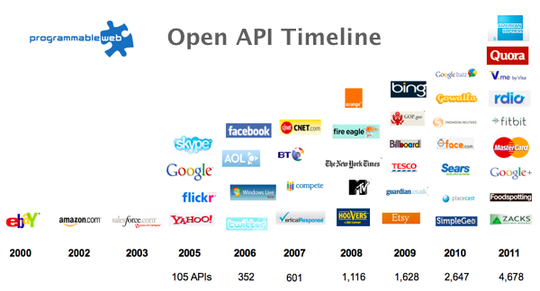
Recap: The Information Revolution

Slide 44
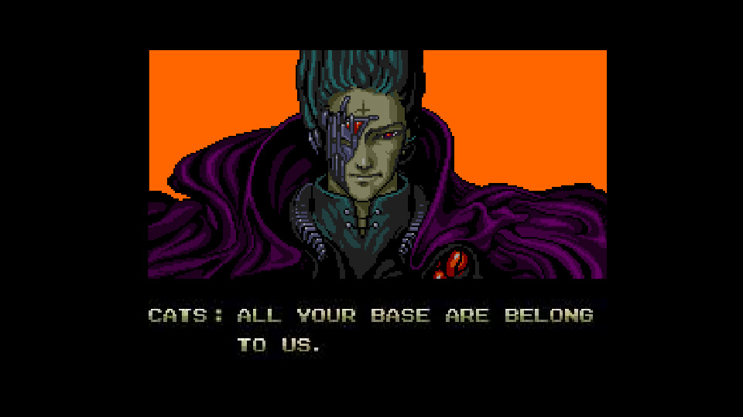
All your types are belong to us….
types

Slide 45
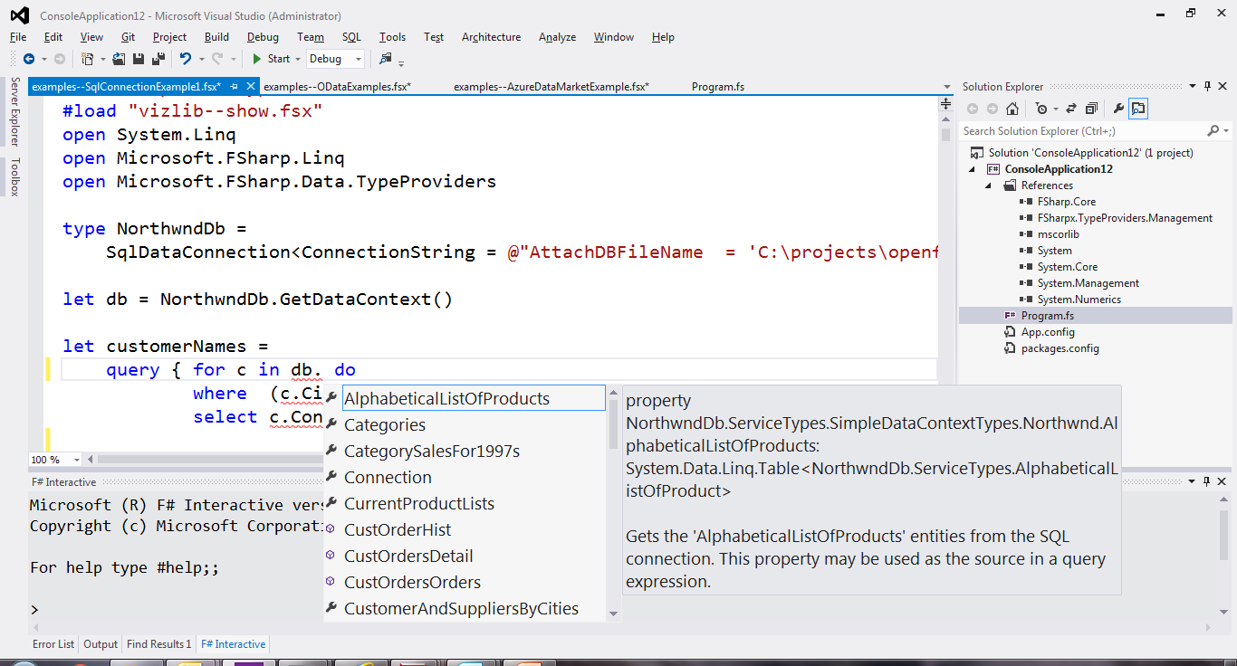
SQL

Slide 46
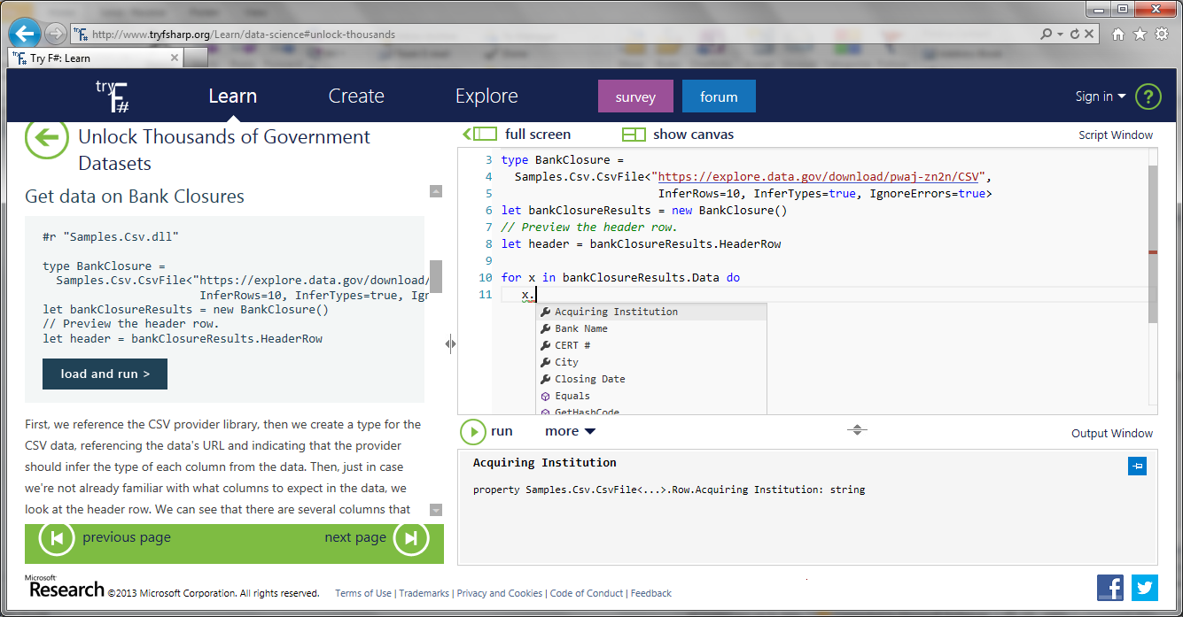
CSV

Slide 47
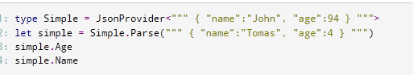
JSON

Slide 48
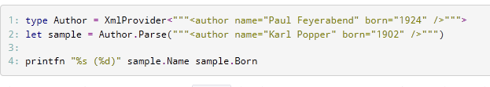
XML

Slide 49
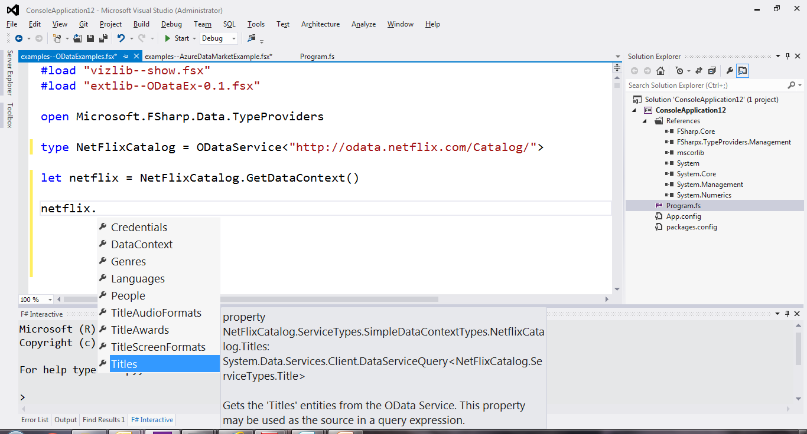
OData

Slide 50
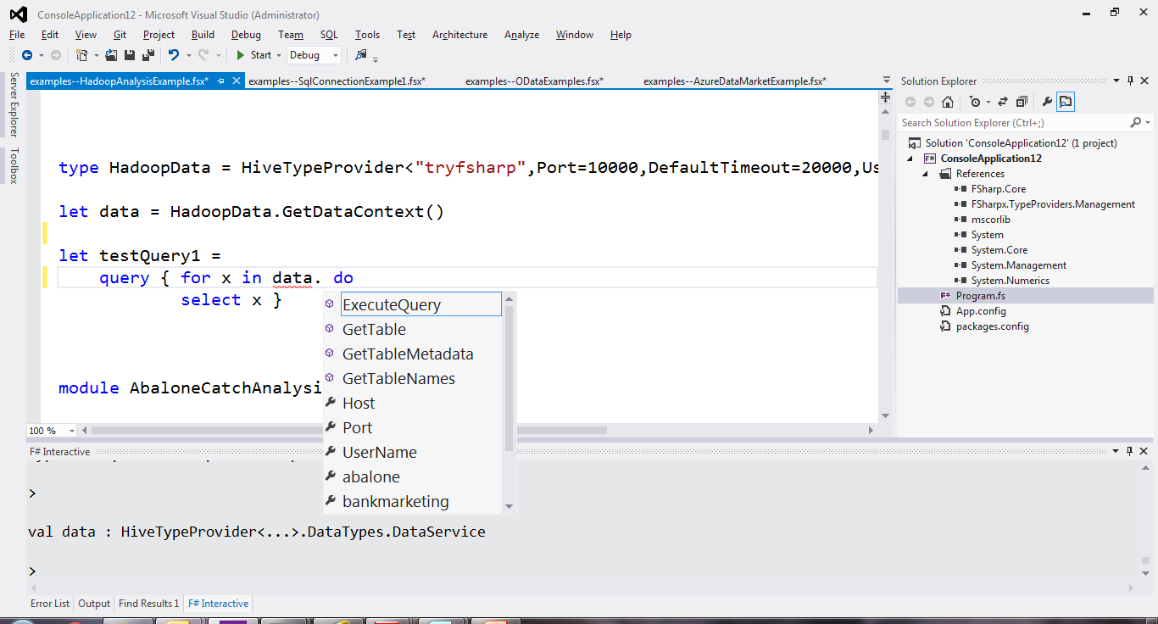
Hadoop/Hive

Slide 51
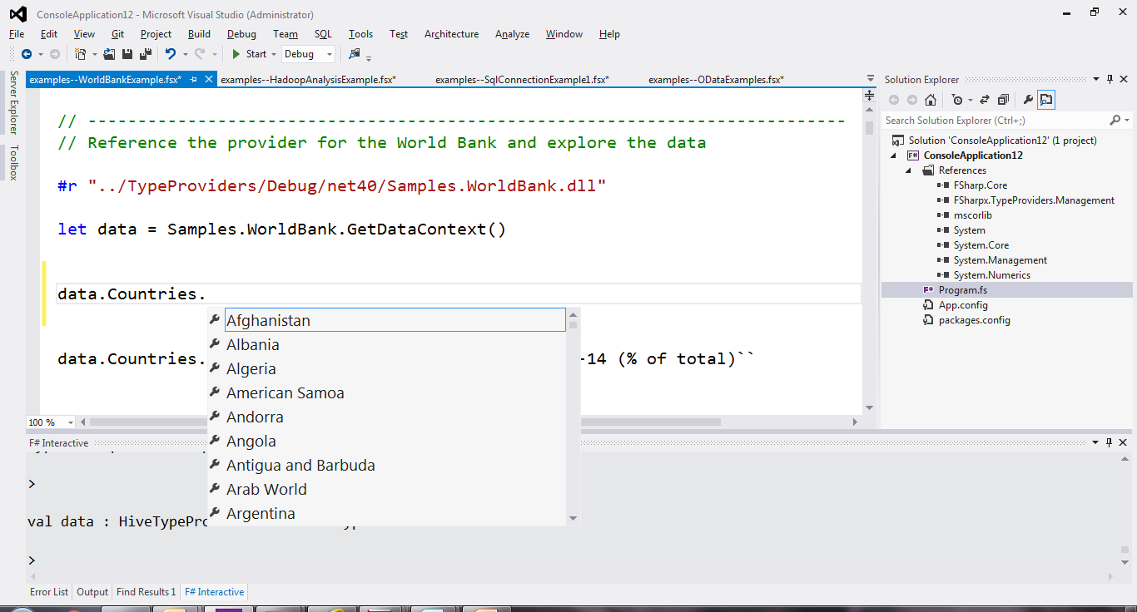
World Bank

Slide 52
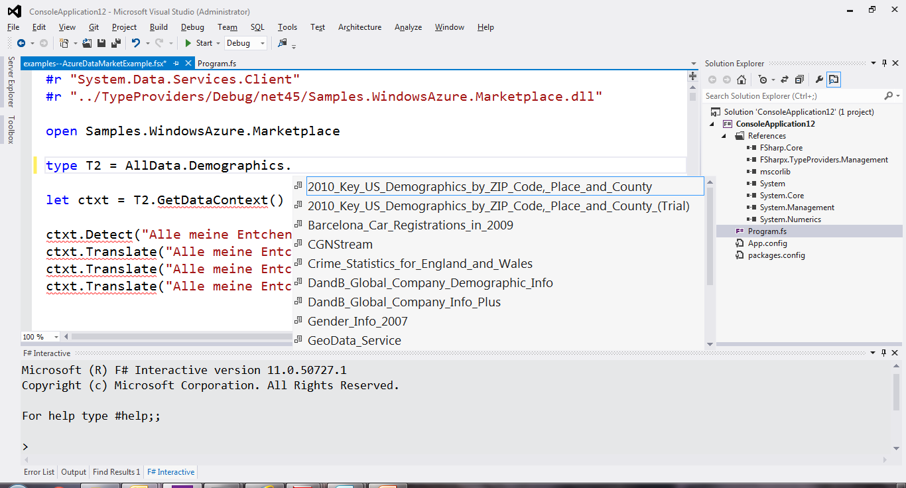
Azure Data Market

Slide 53
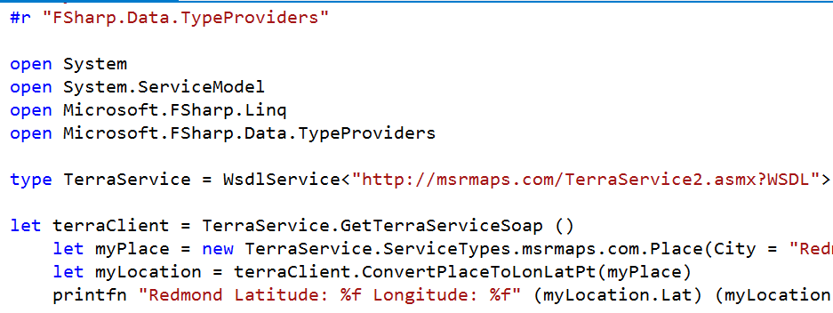
WSDL

Slide 54
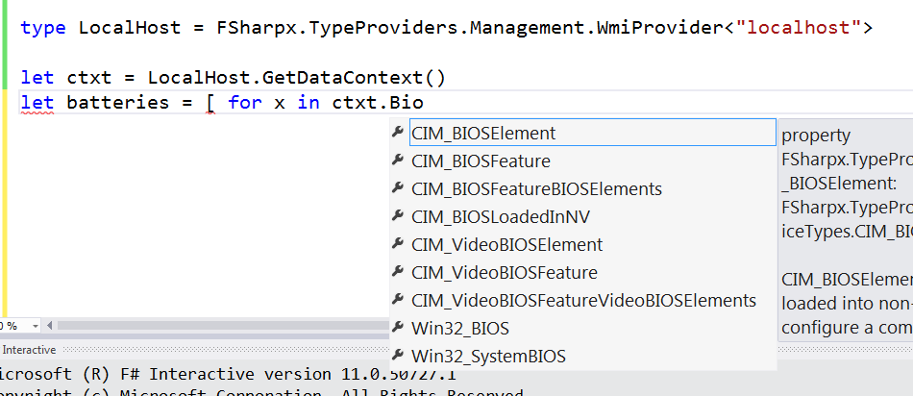
WMI

Slide 55
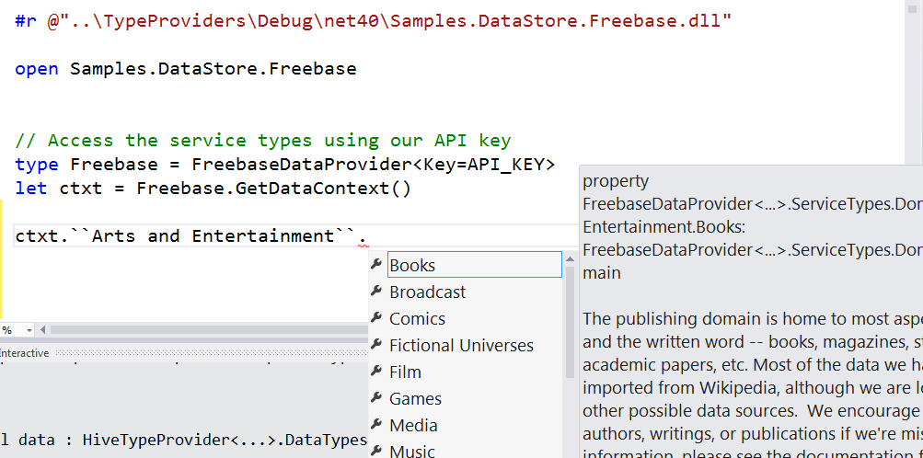
Freebase

Slide 56
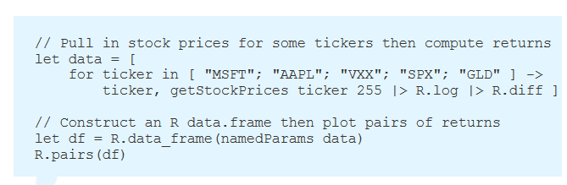
R

Slide 57
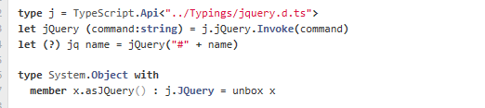
TypeScript

Slide 58
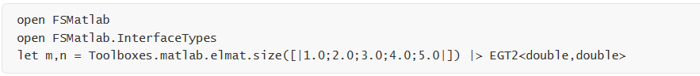
Matlab

Slide 59
Summary
F# is about simplifying data and programming through the wonderful powerful of ML
Originally .NET + Visual Studio + open source
Now also with a open, community-based, cross-platform social reality
http://fsharp.org

